Slide 1





Slide 2

Anomaly Detection
( Keda

Slide 3
About Me
● )%.+Senior Data Scientist
● /*&!AWS
● &,#-
$0'"(

Slide 4
Outline
● anomaly detection
● Anomaly detection
●
!

Slide 5

anomaly detection
“Anomaly detection refers to the problem of finding patternsin data
that do not conform to expectedbehavior.”(Chandola, etc. Anomaly
Detection: A Survey)
Finding patternsmake expectationanomaly
detection

Slide 6
Anomaly detection
• Point anomalies:
üAn individual data instance can be considered as anomalous with respect to the rest of data
üMost use cases are in this category
• Contextual anomalies
üA data instance is anomalous in a specific context (but not otherwise)
üA data instance might be a contextual anomaly in a given context, but an identical data instance could
be considered normal in a different context

Slide 7
Anomaly detectionIT
• Product health monitoring
• Fraud detection

Slide 8
Anomaly detection
• Threshold model
• Fixed threshold
• Moving threshold
• Time series model
• Contextual model
• Percentile models (Tdigest)
• Semi-supervised model

Slide 9
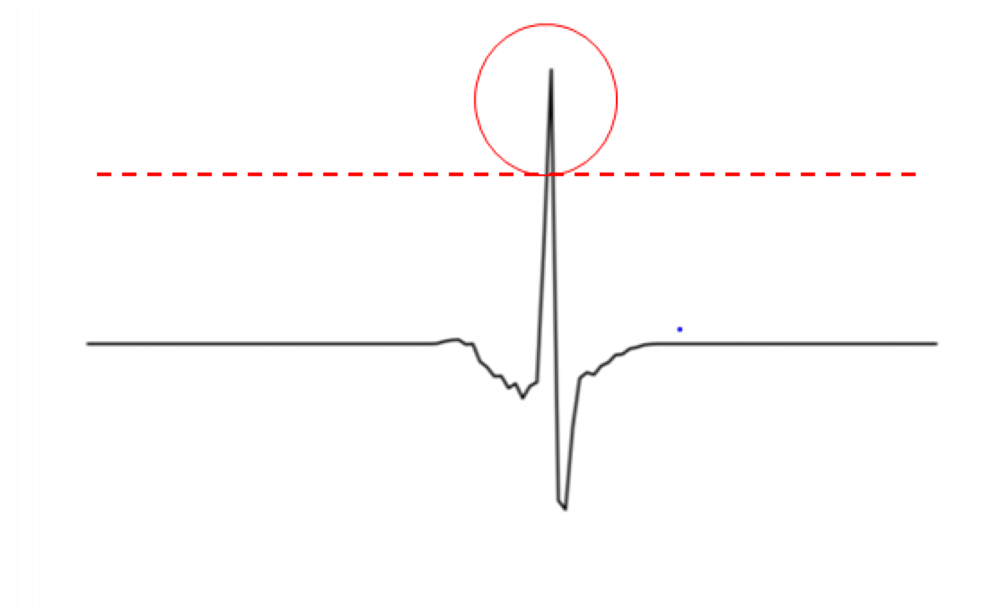
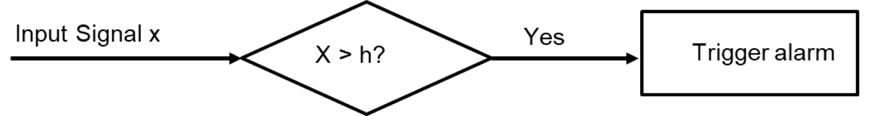
Fixed threshold model
• anomaly detection
• product health monitoring
• Threshold = SLA (Service Level Agreement)
• normal pattern time-related
fluctuations

Slide 10
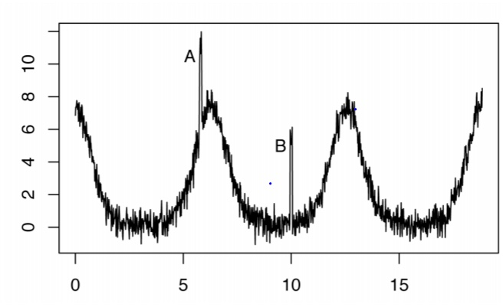
Fixed threshold model
• normal patterntrend, cycle or
seasonality, fixed threshold model won’t
work. #pattern#cycle
fixed threshold &! A"#%
! B"#-B"+contextual
anomalies#-
• (
1. Moving threshold model
2. Time series model to de-trend
',)#$*

